Slide 1
Traffic Camera image analysis QuadCore Productions
A system that makes use of image analysis to gather information about up-to-date traffic on a user specified routes and provides that information to the user via a MOBILE APPLICATION.

Slide 2
Added functionality Since Last Demo
Android
Added new features to our application
Greatly improved the UI design
Server Side

Slide 3
The “WOW” factor…

Slide 4
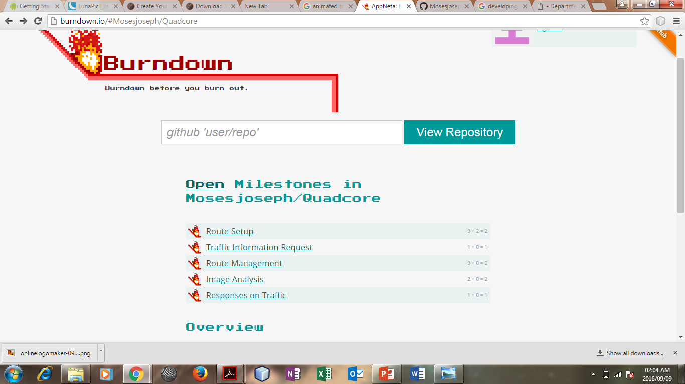
Burndown Chart

Slide 5
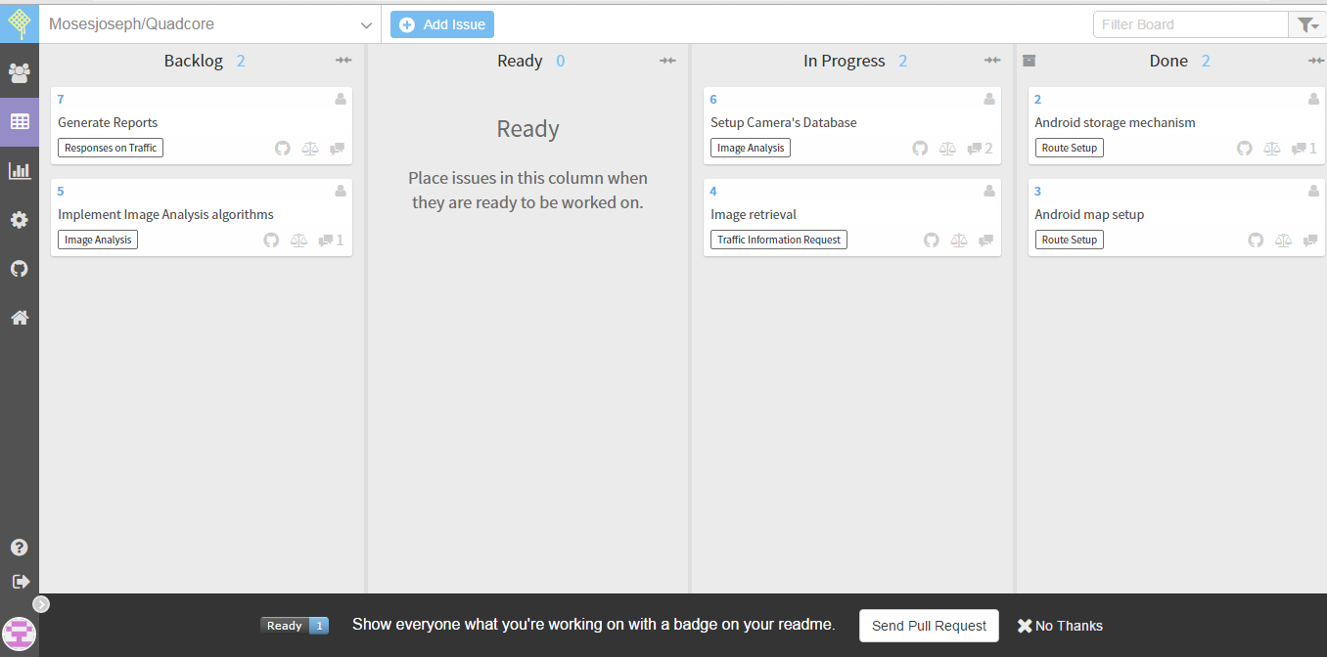
Scrum Board

